Slide 1

Article-level Metrics @ Springer
Martijn Roelandse, Senior Editor

Slide 2
Outline
The importance of Article-level Metrics
ALMs and Springer
ALM team
What does Springer do with ALMs
What does Papers do with ALMs
Conclusions & Outlook
Aknowledgements:
Ciaran O’Neill - BMC
Tanja Rossberg & Els Rens - Springer
Max Haring - SpringerPlus
Ben Blackburne & Matias Piipari - Papers

Slide 3

Which article made a bigger impact?
Article published in a top-tier journal with ‘0’ citations after 2 years
Article published in a lower impact journal with tens of citations
…

Slide 4



Which article made a bigger impact?
Article with many citations
Article widely discussed in the social web
Article with lots of downloads
Article discussed on CNN

Slide 5
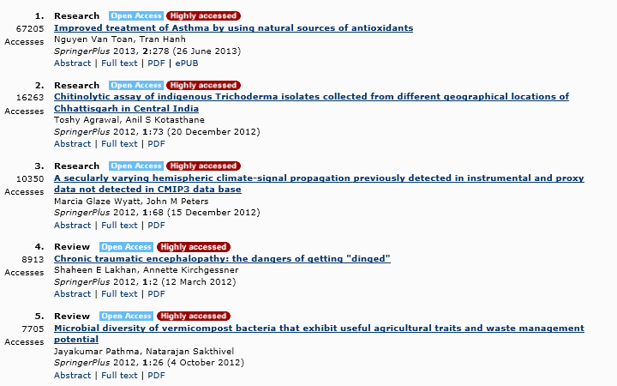
SpringerPlus top downloaded 2013

Slide 6

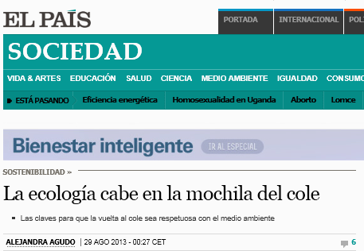
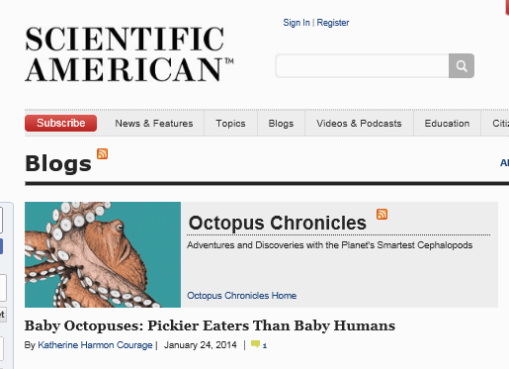
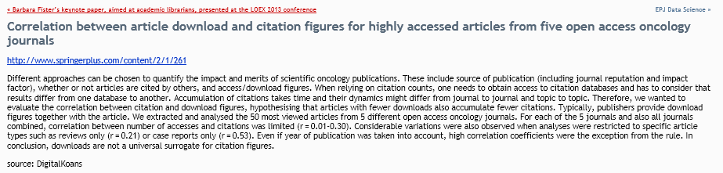
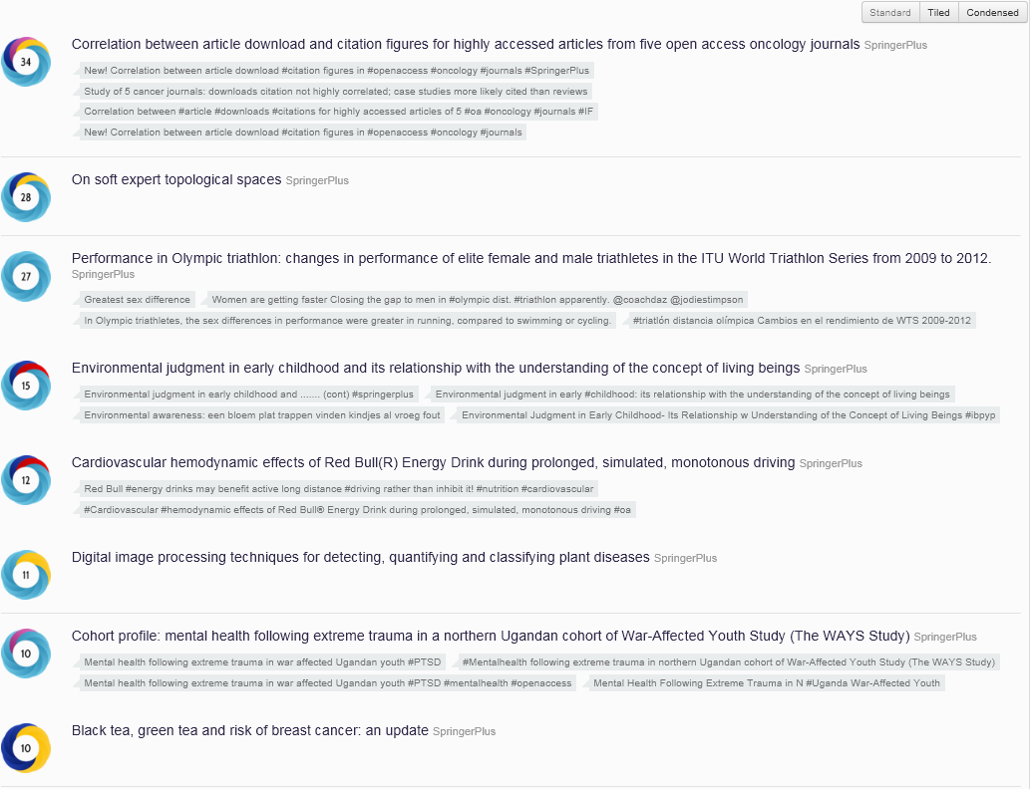



Social Media - altmetric.com/explorer.php

Slide 7
How could they be useful?
Article level metrics present different ways to look at the scientific community’s reaction to a publication, and could help:
filter research for relevance, impact & quality
give an alternative to the Impact Factor in assessing the impact of research
understand of how research findings are disseminated and discovered
research into the relationship of new article level metrics with more traditional measures, i.e. citations
Notes:
Why do we think it's important? Use of article level metrics...
to assist in the efforts to move away from the use of journal level metrics like the Impact Factor of the journal a manuscript is published in as a proxy for assessing the quality or importance of a publication
to give a way for people to filter through large number of publications to find those of greatest impact and quality.
One way of thinking about the peer review process is that it is a acts as a way to filter research, bringing out the most interesting/important work.
Peer-review isn't always effective at this — typically the bulk of citations accrued by a journal are to a small number of articles. In this case it's much better to look at the number of citations that an individual article receives, as opposed to the average number of citations received by articles in the journal that the article has been published in (or the Impact Factor) - the Impact Factor of a journal isn't necessarily a good predictor of the number of citations each article receives. However citations take a long time to accrue, and other article level metrics might be able to give an indication of an article's impact a bit sooner.
The long term aim of article level metrics is to look at the scientific community's reaction to an article using article level metrics following publication — what they are looking at, how much an article is being discussed, and what's being said about — and finding ways to capture and represent the information to help people to navigate the research, and finding out what's of importance to them.
ALMs are important to individual scientists to assess their own output, and also for funding bodies etc. for use in research assessment activities.
Currently the way in which credit is given for publication to look at the Impact Factor of the publishing journal as an indication of the impact of the article —commonly hear that institutions research assessment only crediting research published in journals with an Impact Factor of whatever
ALMs can give an understanding of how research findings are disseminated and accessed
Research is ongoing to better understand the relationship of new article metrics with traditional measures, i.e. citations —some newer measures could provide an indication of the impact of a paper without an extensive lag time
Making the data available allows investigation of questions correlation between the different measures of impact — does wide coverage of an article on social media cites like twitter indicate eventual high number of citations..?

Slide 8
Going forward
article
-level metrics
journal
-level metrics
chapter
-level metrics
book
-level metrics
data
-level metrics
person
-level metrics
…
-level metrics

Slide 9

Meet our sample article @ Springer
http://link.springer.com/article/10.1186/1741-7015-9-52

Slide 10
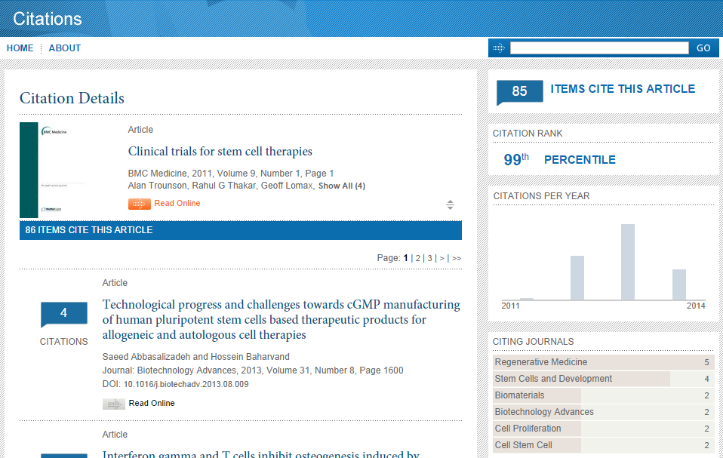
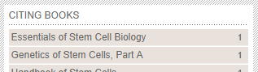
Meet our sample article @ CrossRef / citations.springer.com
http://citations.springer.com/item?doi=10.1186/1741-7015-9-52

Slide 11
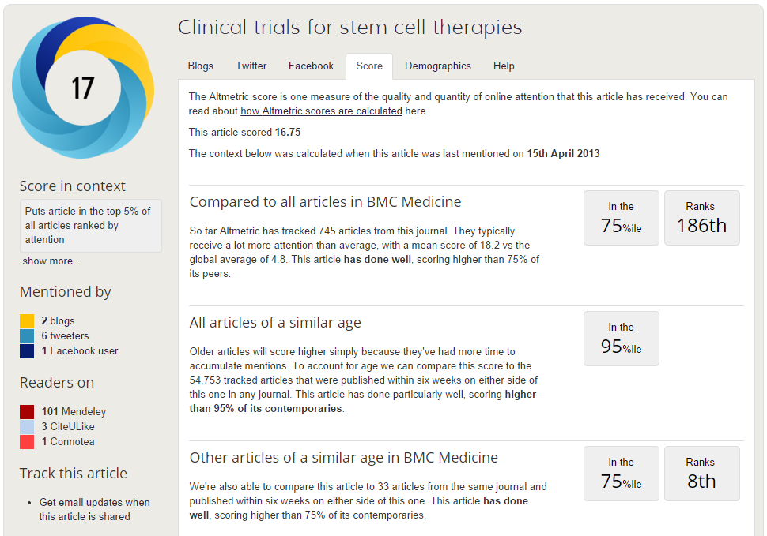
Meet our sample article @ Altmetric
=> i.e. 7 tweets
http://www.altmetric.com/details.php?citation_id=242381

Slide 12
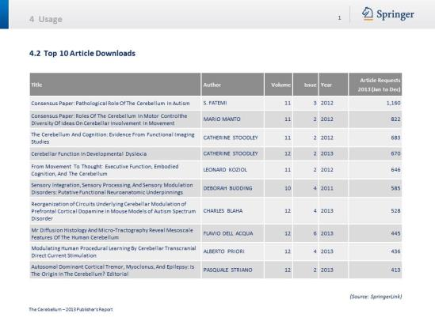
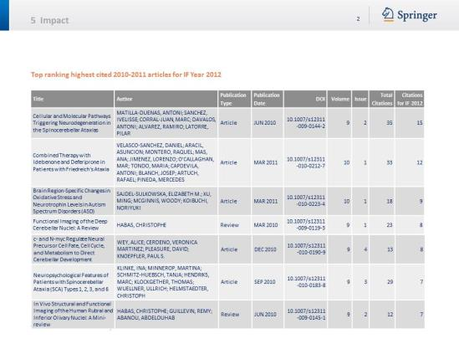
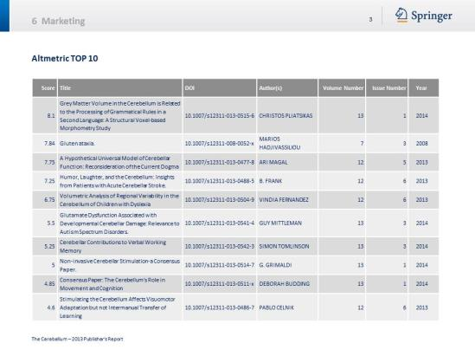
ALMs in Annual Journal Report

Slide 13
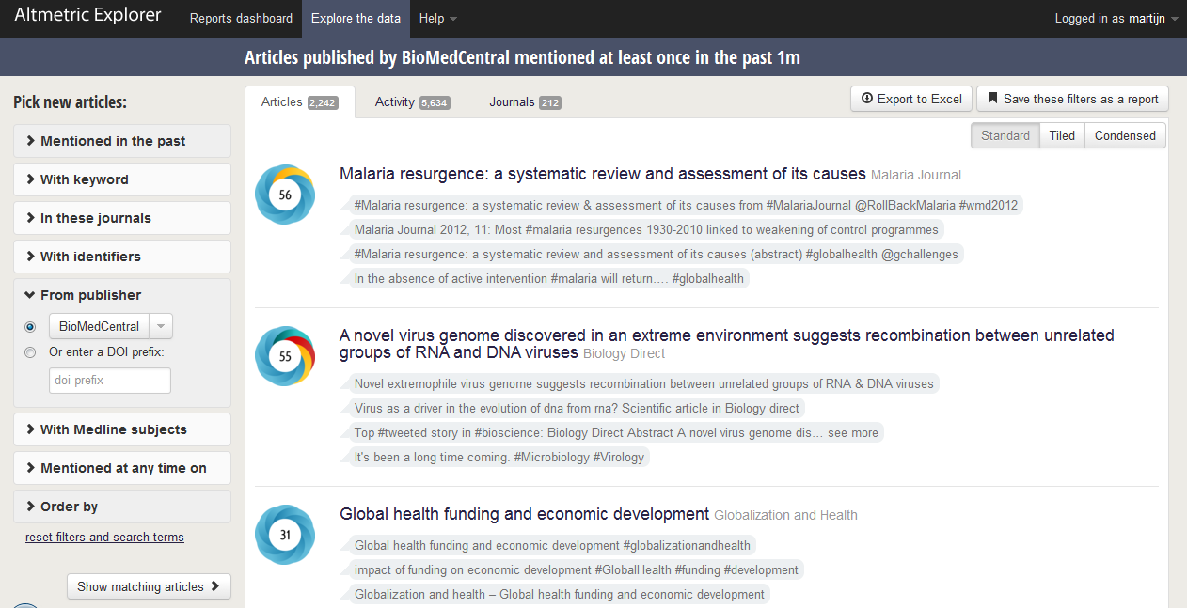
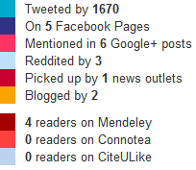
Altmetrics Explorer – monitor and kudos

Slide 14






Marketing
‘Translating’ article level metrics data into attractive promotional messages
Highlighting the top shared, cited, downloaded articles of key journals
Highlights:
NeuroStars
Week of Citations

Slide 15
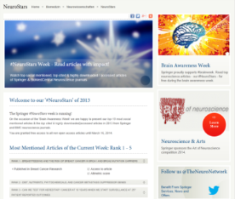
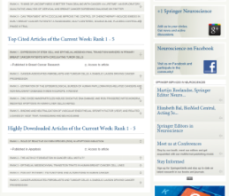
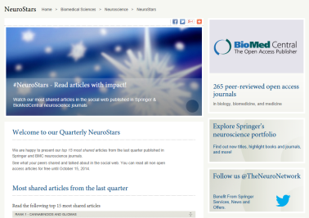
NeuroStars
The first ALM driven promotional campaign from Springer, launched December 2012
Campaign duration 2014: March 10-16, in time for the Brain Awareness Week (jointly with BioMed Central)
Article selection: Top 15 shared, top cited, top downloaded articles from all journals in the field
Now available: Quarterly NeuroStars
A permanent website on springer.com presenting the top shared articles in Neuroscience from Springer and BioMed Central – updated on a quarterly basis
http://www.springer.com/neurostars

Slide 16






Diversity of Citations Metrics
What is the impact of an article?
When assessing the impact of a published research article, it might seem logical to look at the Impact Factor of the journal that you find it in. But as journals and scholars have moved online, and citation indexing has been automated, the wealth of information for citation discovery and analysis has vastly increased.
Citation counts can tell a more accurate story about the scholarly impact that an individual article has made than the journal Impact Factor. But where should you look for these counts? There are a number of indexing services tracking and providing information about citations, each with advantages and disadvantages, spanning from bias to discipline-dependence, and limitations of the citation data source.

Slide 17
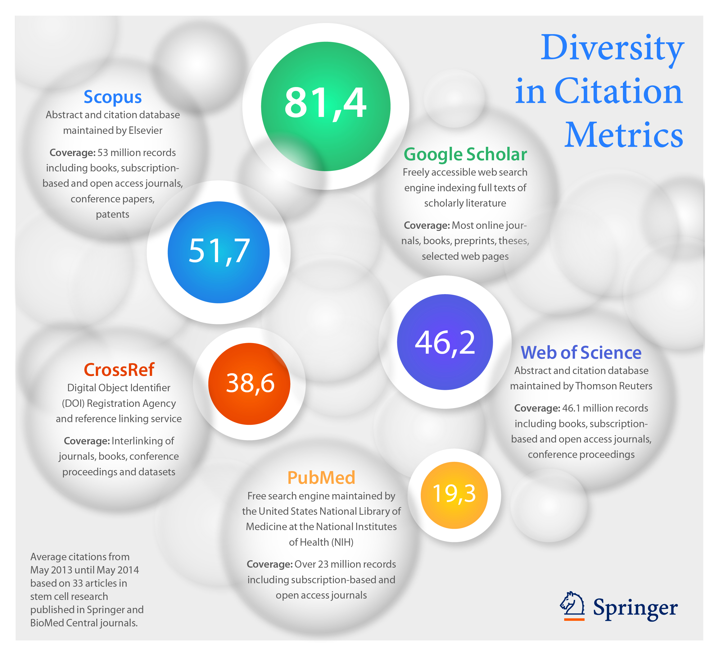

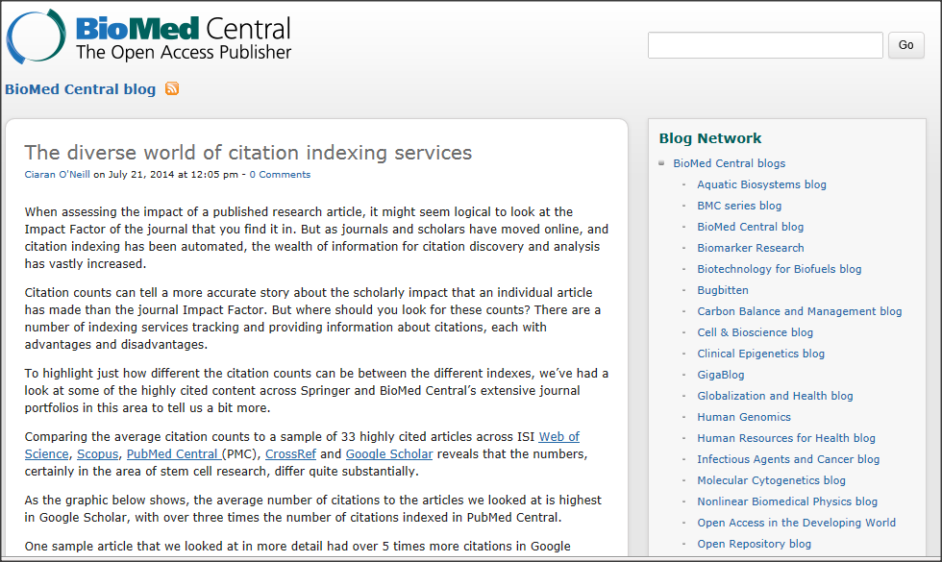
“How many citations do you have?”
An often heard question in the academic realm:
That depends on the platform! Let’s have a look…

Slide 18
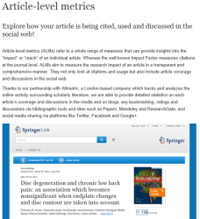
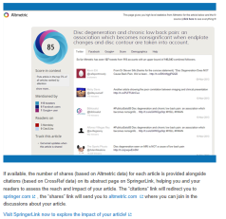
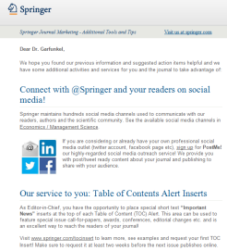
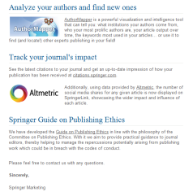

Informing our authors and editors about ALMs
A dedicated ALM website informing our journal authors and editors is available on springer.com Visit the Article-level metrics site for journal authors and editors
eCampaign for Editor-in-Chief
Author Zone newsletter

Slide 19
Introducing the ALM virtual team
Editorial
Marketing
BioMed Central and SpringerOpen
IT Platform Development Publishing Development
Academic/Government Marketing & Account Development Corporate Marketing & Account Development
Author & Partner Marketing & Services
Market Intelligence & Webanalytics

Slide 20
And ALMs

Slide 21
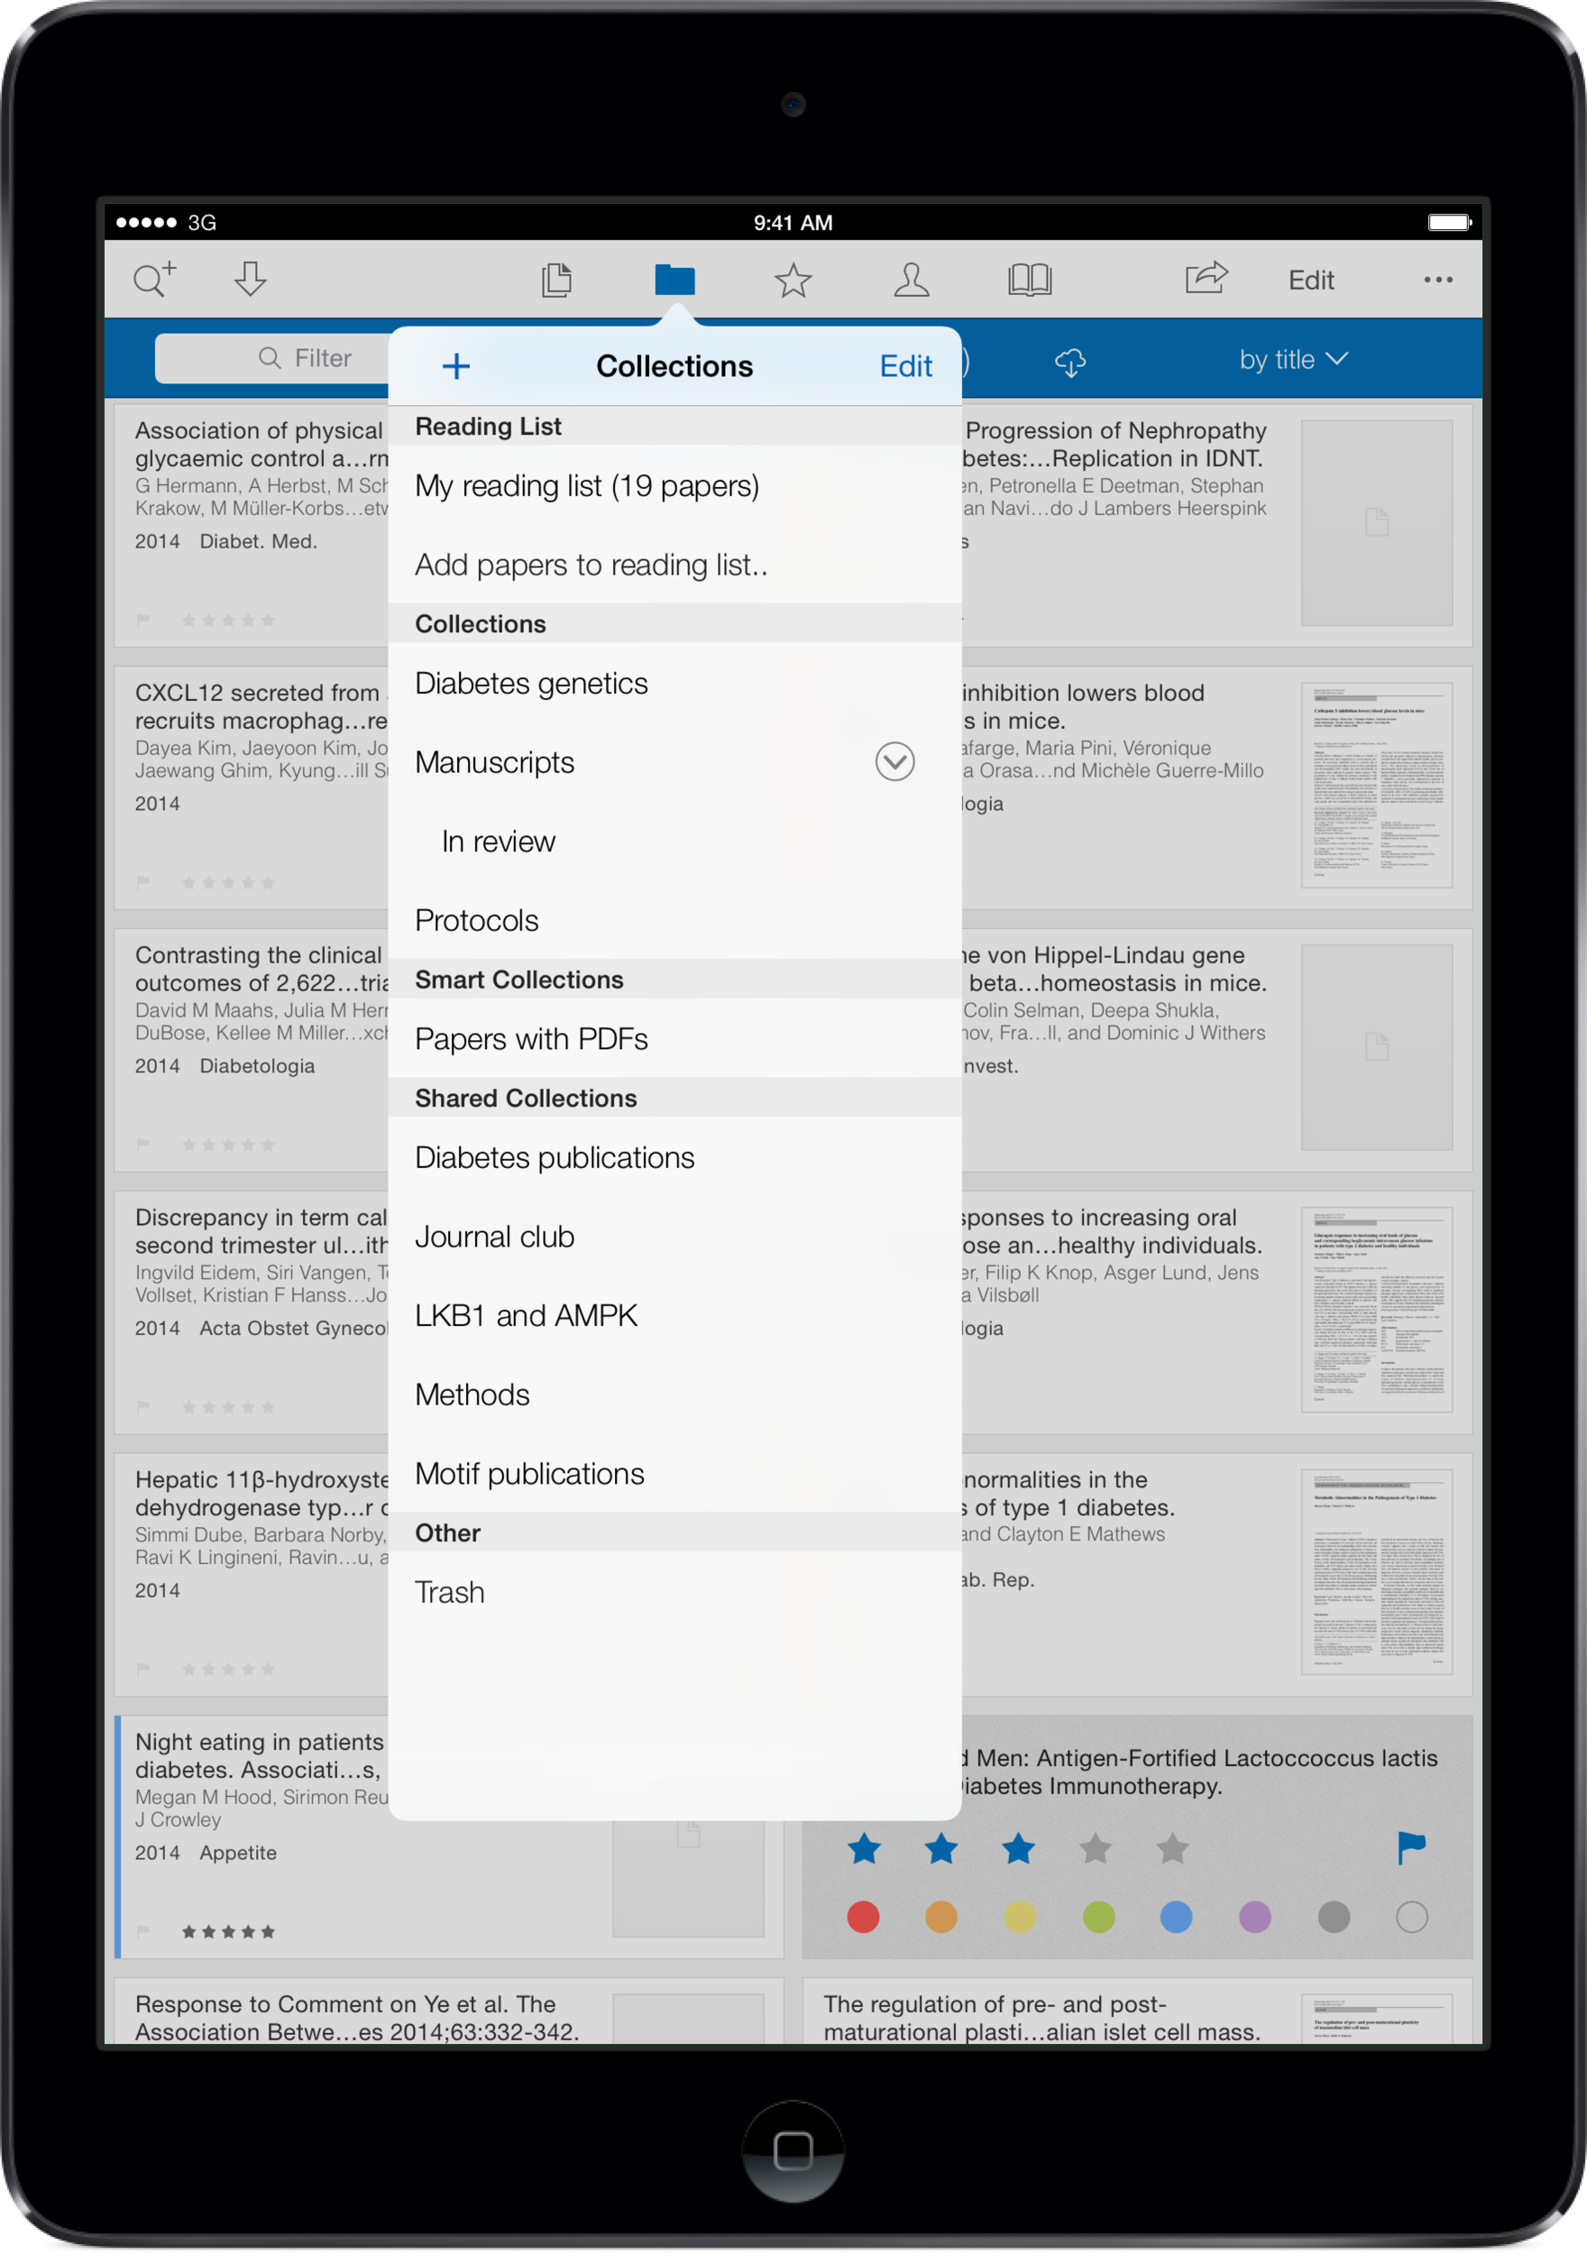

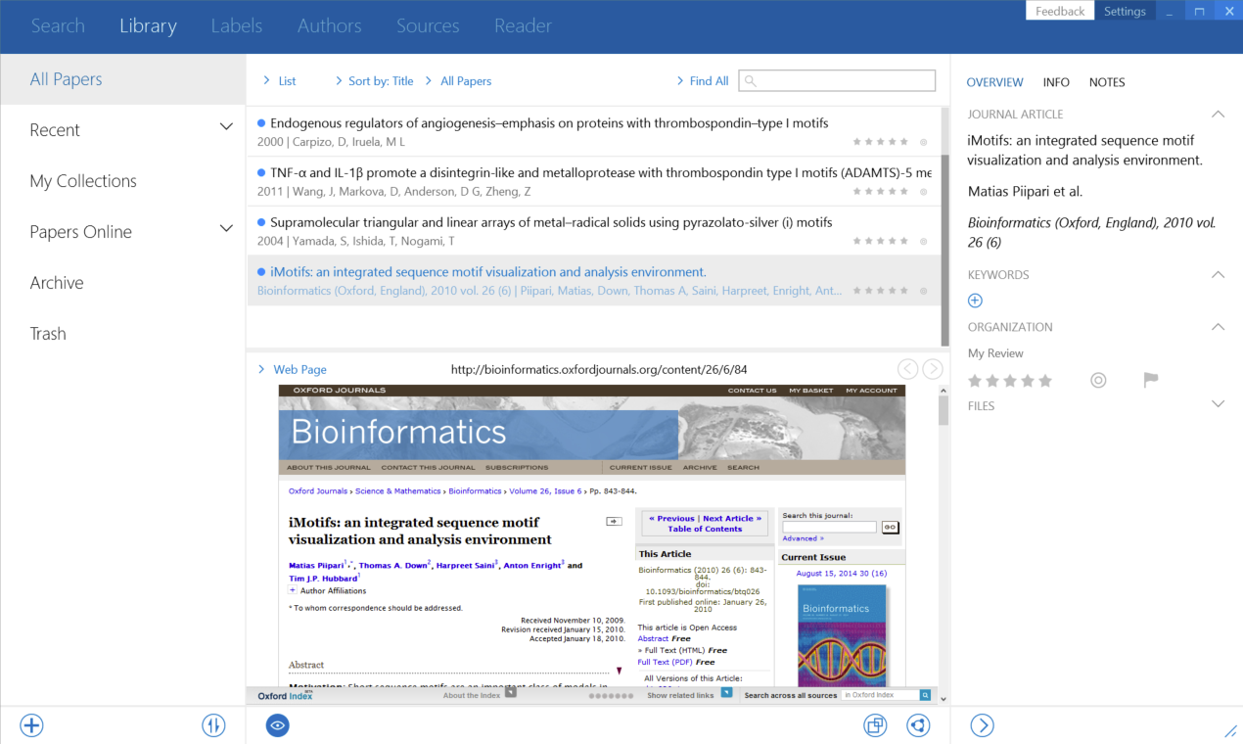

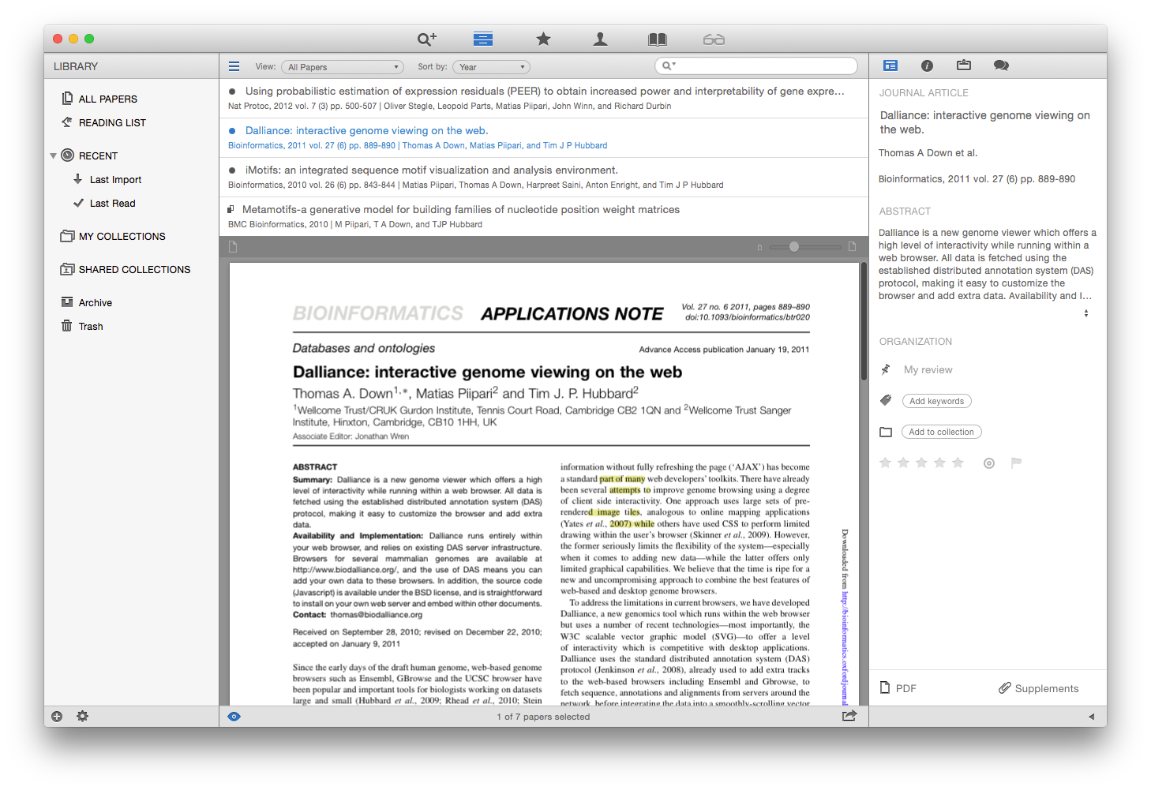
Offline / off-site access on Mac, PC, iOS
Notes:
Single external user, requires access for collaboration with institution
Full text documents can not be stored in a secure Papers institutional environment for copyright and Information Security policy.
Links back to the documents can be stored
Either direct links to the item or via links to the item via link resolver (preferred method).

Slide 22




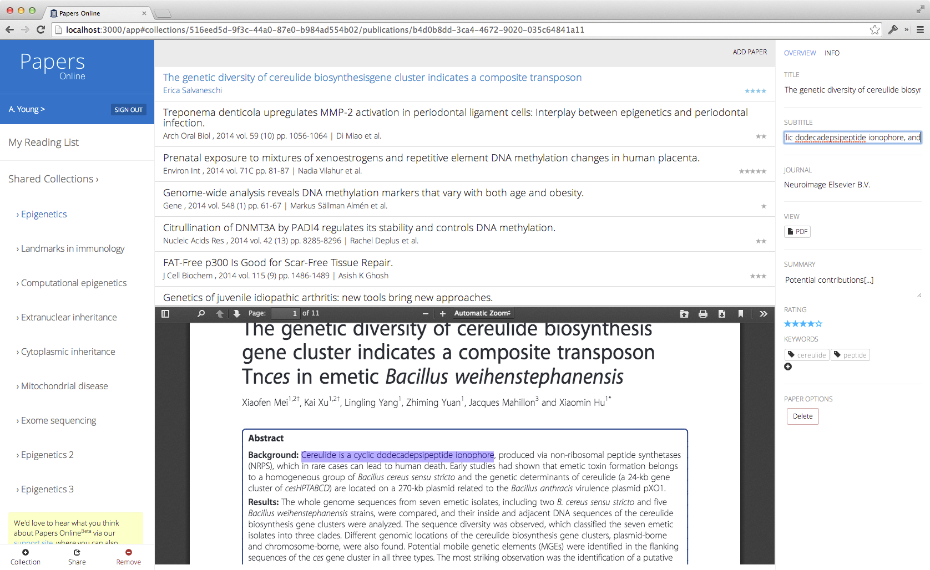
Papers Online
Notes:
Access is web browser agnostic (IE, Chrome, Firefox, Safari)
Yes
Adaptive or responsive design for multiple devices, device agnostic (Windows PC, iOS tablet or phone, Android tablet or phone devices).

Slide 23
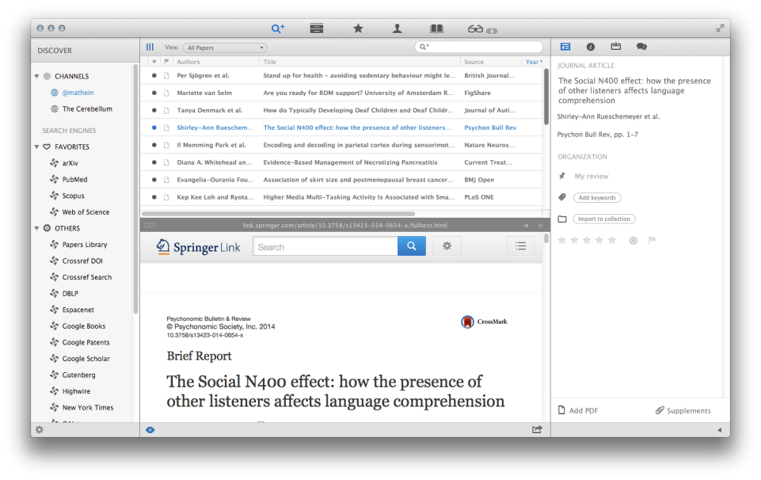
Notes:
Access is web browser agnostic (IE, Chrome, Firefox, Safari)
Yes
Adaptive or responsive design for multiple devices, device agnostic (Windows PC, iOS tablet or phone, Android tablet or phone devices).

Slide 24
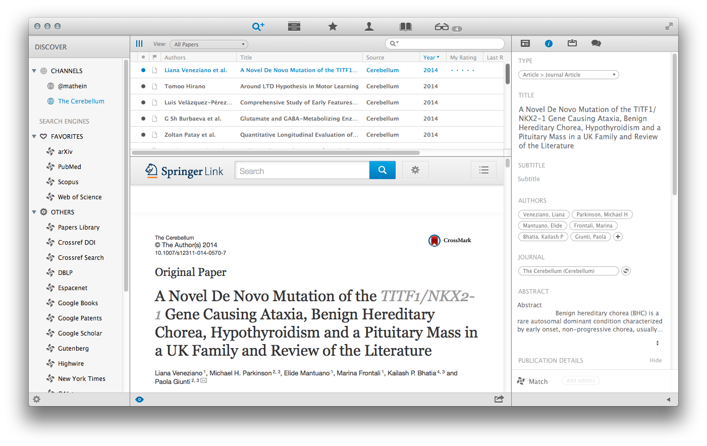
Notes:
Access is web browser agnostic (IE, Chrome, Firefox, Safari)
Yes
Adaptive or responsive design for multiple devices, device agnostic (Windows PC, iOS tablet or phone, Android tablet or phone devices).

Slide 25
Article Level Metrics Conclusion & Outlook

Slide 26
Concluding – Article Level Metrics
A more accurate evaluation of scholarly performance
Show dissemination of an article through scholarly and non-scholarly communication
A new benchmark for employers, funders, potential collaborators
Provide filters to select those articles most relevant for their work

Slide 27
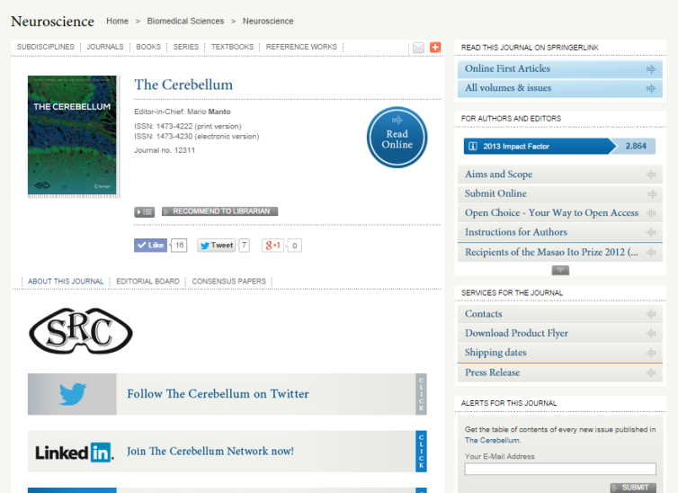
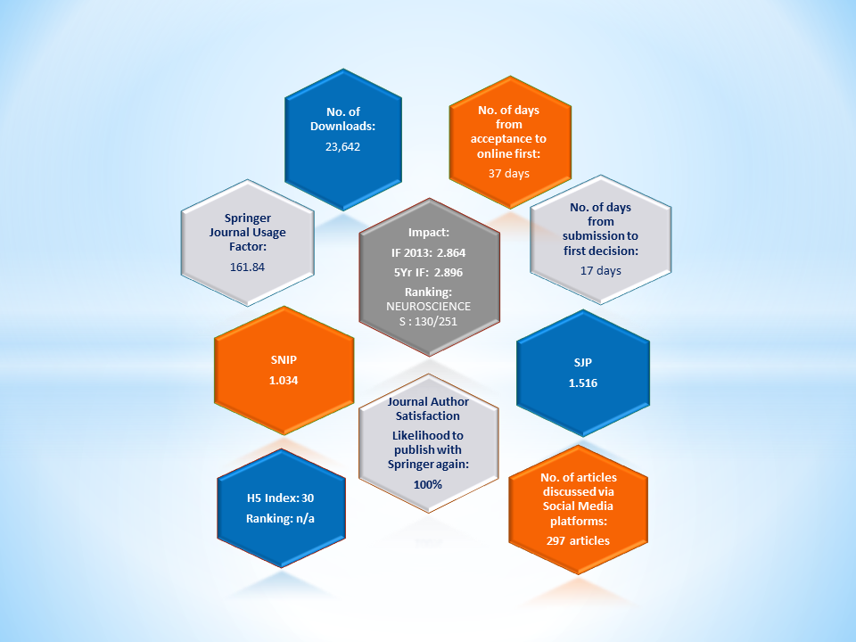
Journal-level metrics

Slide 28
Questions?

